Slide 1
Bayesian Networks
CMPT 310
Simon Fraser University
CHAPTER 14
Oliver Schulte

Slide 2
Environment Type: Uncertain
Fully Observable
yes
no
Deterministic
no
yes
Certainty: Search
Uncertainty

Slide 3
Knowledge Representation

Slide 4
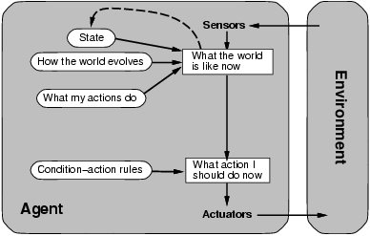
Model-based Agents
Know how world evolves
Overtaking car gets closer from behind
How agents actions affect the world
Wheel turned clockwise takes you right
Model-based agents update their state.
Can also add goals and utility/performance measures.

Slide 5
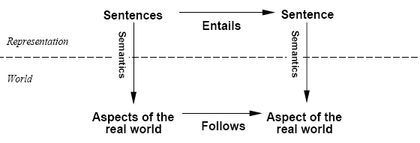
Schematic perspective
If representation is true in the real world, then any fact derived
from representation by a sound inference procedure is also true in the real world.
Notes:
See also Assignment 3.

Slide 6
Environment Representations
Graph-Based Search: State is black box, no internal structure, atomic. Contrast: Missionaries and Cannibals.
Factored Representation: State is list/vector of facts.
Facts can be expressed in formal logic.
Notes:
think of missionaries and cannibals.

Slide 7
Goals of Knowledge Representation (I)
Problem Description.
Describe the problem in terms of facts and rules.
Computer generates the state graph.
David Mitchell. Eugenia Ternovska.

Slide 8

Goals of Knowledge Representation (II)
Deduction. Inference beyond the input facts.
Notes:
see deductive databases

Slide 9
Goals of Knowledge Representation (III)
Solution.
Describe the problem in terms of facts and rules.
Computer solves the problem using logical inference.
Notes:
see deductive databases

Slide 10
Knowledge Representation Issues
The Relevance Problem.
The Completeness problem.
The Inference Problem.
The Decision Problem.
The Robustness problem.

Slide 11
Probabilistic Knowledge Representation
Bayesian networks

Slide 12
Probabilistic Inference
What is P(A|K)?
Read: probability of A given Knowledge.
Model-based
Rule-based
Sum over possible worlds
Probability Calculus
Product Rule
Marginalization
Bayes’ theorem

Slide 13
Bayes Nets: General Points
Represent domain knowledge.
Possibly a lot of it.
Allow for uncertainty.
Represent causal relations.
Fast answers to types of queries:
Probabilistic: What is the probability that a patient has strep throat given that they have fever?
Relevance: Is fever relevant to having strep throat?

Slide 14
Knowledge Representation Format
 | Logic | Bayes nets
Basic Unit | Literal | Random Variable
Format | (Horn) Clauses | Variable Graph (Directed) + Probability Horn clauses
Inference | Resolution | Belief Propagation Product-Sum (not covered)
Notes:
See aispace.org

Slide 15
Bayesian Network LInks
Judea Pearl's Turing Award
Used in many applications: medical diagnosis, office clip, …
400-page book about applications.
Companies: Hugin, Netica, Microsoft.
Notes:
look up companies on-line

Slide 16
Basic Concepts

Slide 17
Bayesian Network Structure
A graph where:
Each node is a random variable.
Edges are directed.
There are no directed cycles (directed acyclic graph).
Notes:
DAG is equivalent to the existence of a topological ordering.

Slide 18
Example: Bayesian Network Graph
Cavity
Catch
toothache
Notes:
These are easy to draw in the AI space tool.

Slide 19
Bayesian Network
A Bayesian network structure +
For each node X, for each value x of X, a conditional probability P(X=x|Y₁ = y₁,…,Y_{k} = y_{k}) = p for every assignment of values to the parents of X.
Demo in AIspace tool

Slide 20
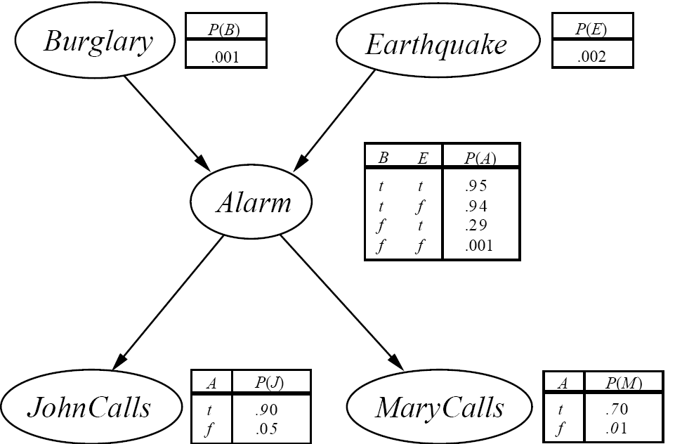
Example: Complete Bayesian Network
Notes:
Example Horn Clauses: Alarm -> JohnClass p:0.9

Slide 21
The Story
You have a new burglar alarm installed at home.
It’s reliable at detecting burglary but also responds to earthquakes.
You have two neighbors that promise to call you at work when they hear the alarm.
John always calls when he hears the alarm, but sometimes confuses alarm with telephone ringing.
Mary listens to loud music and sometimes misses the alarm.

Slide 22
Bayesian Networks and Horn Clauses
Let P(X=x|Y₁ = y₁,…,Y_{k} = y_{k}) = p be a conditional probability specified in a BN.
This can be interpreted as a probability clause P(X = x) = p ⬅ Y₁ = y₁,…,Y_{k} = y_{k.}
if parents = values, then child = value with probability p
A Bayes net can be seen as a knowledge base containing probability clauses.
For short, a probabilistic knowledge base.
Notes:
Example Horn clauses
Alarm -> JohnCalls; p = 0.9
Not Alarm -> JohnCalls; p = 0.05.
Reference: Haddaway, Langley, Kerstin and de Raedt.

Slide 23
Bayes Nets Encode the Joint Distribution

Slide 24
Bayes Nets and the Joint Distribution
A Bayes net compactly encodes the joint distribution over the random variables X₁,…,X_{n}. How?
Let x₁,…,x_{n} be a complete assignment of a value to each random variable. Then P(x₁,…,x_{n}) = Π P(x_{i}|parents(X_{i})) where the index i=1,…,n runs over all n nodes.
This is the product formula for Bayes nets.
Notes:
demo with cavity network and compare with joint queries

Slide 25
Computing The Product
In words, the joint probability is computed as follows.
For each node X_{i}:
Find the assigned value x_{i}.
Find the values y₁,..,y_{k} assigned to the parents of X_{i}.
Look up the conditional probability P(x_{i}|y₁,..,y_{k}) in the Bayes net.
Multiply together these conditional probabilities.

Slide 26
Product Formula Example: Burglary
Query: What is the joint probability that all variables are true?
P(M, J, A, E, B) = P(M|A) p(J|A) p(A|E,B)P(E)P(B) = .7 x .9 x .95 x .002 x .001

Slide 27
Cavity Example
Query: What is the joint probability that there is a cavity but no toothache and the probe doesn’t catch?
P(Cavity = T, toothache = F, Catch = F) = P(Cavity= T) p(Toothache = F|Cavity = T) p(Catch = F|Cavity = T) = .2 x .4 x .1 = 0.008
Cavity
Catch
toothache
Notes:
Example calculations:
compare with joint distribution!

Slide 28
Compactness of Bayesian Networks
Consider n binary variables
Unconstrained joint distribution requires O(2^{n}) probabilities
If we have a Bayesian network, with a maximum of k parents for any node, then we need O(n 2^{k}) probabilities
Example
Full unconstrained joint distribution
n = 30: need 10⁹ probabilities for full joint distribution
Bayesian network
n = 30, k = 4: need 480 probabilities
Notes:
Recall toothache example where we directly represented the joint distribution.

Slide 29
Completeness of Bayes nets
The Bayes net encodes all joint probabilities.
Knowledge of all joint probabilities is sufficient to answer any probabilistic query.
A Bayes net can in principle answer every query.
Notes:
Demo in AIspace using cavity example.

Slide 30
Is it Magic?
Why does the product formula work?
The Bayes net topological or graphical semantics.
The graph by itself entails conditional independencies.
The Chain Rule.

Slide 31
Bayes Nets Graphical Semantics

Slide 32
Common Causes: Spot the Pattern
Cavity
Catch
toothache
Catch is independent of toothache given Cavity.
Notes:
In UBC “Simple Diagnostic Example:
Fever is independent of Coughing Given Influenza.
Coughing is independent of Fever given Bronchitis.

Slide 33
Burglary Example
JohnCalls, MaryCalls are conditionally independent given Alarm.

Slide 34
Spot the Pattern: Chain Scenario
MaryCalls is independent of Burglary given Alarm.
JohnCalls is independent of Earthquake given Alarm.
Notes:
This is typical for sequential data.
In UBC “Simple Diagnostic Example:
Wheezing is independent of Influenza Given Bronchitis.
Coughing is independent of Smoke given Bronchitis.
Influenze is independent of Smokes. [check assignment]

Slide 35
The Markov Condition
A Bayes net is constructed so that: each variable is conditionally independent of its nondescendants given its parents.
The graph alone (without specified probabilities) entails conditional independencies.
Notes:
1. This can always be achieved by letting a node have enough parents. See text for details on how to construct a Bayesian network.
2. This is also called the Markov condition.
3. Helps with the retrieve relevant problem: from the graph we can tell that certain information is ignorable.
Can work on this using “spot the pattern”.

Slide 36
Exercise
In the AISpace car starting belief network, does the Markov condition entail the following statements?
Conditional on Spark Plugs and Voltage at Plug, Spark Quality is independent of Spark Timing.
Conditional on Spark Plugs and Voltage at Plug, Spark Quality is independent of Car Starts.

Slide 37
Derivation of the Product Formula

Slide 38
The Chain Rule
We can always write
P(a, b, c, … z) = P(a | b, c, …. z) P(b, c, … z) (Product Rule)
Repeatedly applying this idea, we obtain
P(a, b, c, … z) = P(a | b, c, …. z) P(b | c,.. z) P(c| .. z)..P(z)
Order the variables such that children come before parents.
Then given its parents, each node is independent of its other ancestors by the Markov condition.
P(a,b,c, … z) = Π_{x}. P(x|parents)
Notes:
Accompany this with blackboard demonstration of the BN graph.

Slide 39
Example in Burglary Network
P(M, J,A,E,B) = P(M| J,A,E,B) p(J,A,E,B)= P(M|A) p(J,A,E,B)
= P(M|A) p(J|A,E,B) p(A,E,B) = P(M|A) p(J|A) p(A,E,B)
= P(M|A) p(J|A) p(A|E,B) P(E,B)
= P(M|A) p(J|A) p(A|E,B) P(E)P(B)
Colours show applications of the Markov condition.

Slide 40
Explaining Away

Slide 41
Common Effects: Spot the Pattern
Influenza and Smokes are independent.
Given Bronchitis, they become dependent.
Influenza
Smokes
Bronchitis
Battery Age
Charging System OK
Battery Age and Charging System are independent.
Given Battery Voltage, they become dependent.
Battery Voltage
Notes:
From UBC “Simple diagnostic problem”
Does this make sense?

Slide 42
Conditioning on Children produces conditional dependencies
Independent Causes:
A and B are independent.
“Explaining away” effect:
Given C, observing A makes B less likely.
E.g. Bronchitis in UBC “Simple Diagnostic Problem”.
A and B are (marginally) independent, become dependent once C is known.
A
B
C
This pattern requires an extension of the Markov condition known as d-separation.
Notes:
Another example: Wumpus on one square explains stench.

Slide 43
Mathematical Analysis
Theorem: If A, B have no common ancestors and neither is a descendant of the other, then they are independent of each other.
Proof for our example:
P(a,b) = Σ_{c} P(a,b,c) = Σ_{c} P(a) P(b) P(c|a,b) = P(a) P(b) Σ_{c} P(c|a,b) = P(a) P(b)
A
B
C
Notes:
Not quite a proof because we A,B may have parents. But illustrates general idea.
First step follows from marginilization. Second step follows from product formula.
3rd step follows since P(a), P(b) do not depend on c. Last step follows P(c|a,b) adds up to 1 over possible c values.

Slide 44
Bayes’ Theorem

Slide 45
Abductive Reasoning
Edges are often causal, from cause to effect.
Many important queries are diagnostic, from effect to cause.
This reversal is difficult to capture with logic
Cavity
Toothache
Notes:
But not impossible in logic: see nonmonotonic reasoning. Horn clauses
Black: causal direction.
Red: direction of inference.
(e.g. logical Horn clauses).

Slide 46
Bayes’ Theorem: Another Example
A doctor knows the following.
The disease meningitis causes the patient to have a stiff neck 50% of the time.
The prior probability that someone has meningitis is 1/50,000.
The prior that someone has a stiff neck is 1/20.
Question: knowing that a person has a stiff neck what is the probability that they have meningitis?

Slide 47
Spot the Pattern: Diagnosis
P(Cavity) | P(Toothache|Cavity) | P(Toothache) | P(Cavity|Toothache)
0.2 | 0.6 | 0.2 | 0.6
P(Meningitis) | P(Stiff Neck| Meningitis) | P(Stiff Neck) | P(Meningitis|Stiff Neck)
1/50,000 | 1/2 | 1/20 | 1/5,000
Notes:
How does the last number depend on the first three?

Slide 48
Spot the Pattern: Diagnosis
P(Cavity) | x | P(Toothache|Cavity) | / | P(Toothache) | = | P(Cavity|Toothache)
0.2 |  | 0.6 |  | 0.2 |  | 0.6
P(Meningitis) | x | P(Stiff Neck| Meningitis) | / | P(Stiff Neck) | = | P(Meningitis|Stiff Neck)
1/50,000 |  | 1/2 |  | 1/20 |  | 1/5,000

Slide 49
Explain the Pattern: Bayes’ Theorem
Exercise: Prove Bayes’ Theorem
P(A | B) = P(B | A) P(A) / P(B).

Slide 50
On Bayes’ Theorem
P(a | b) = P(b | a) P(a) / P(b).
Useful for assessing diagnostic probability from causal probability: P(Cause|Effect) = P(Effect|Cause) P(Cause) / P(Effect).
Likelihood: how well does the cause explain the effect?
Prior: how plausible is the explanation before any evidence?
Evidence Term/Normalization Constant: how surprising is the evidence?
Notes:
The better the cause explains the effect, the more likely it is.
The more plausible the cause is, the more likely it is.
The more surprising the evidence (the lower its prior probability), the greater its impact.

Slide 51
Other Topics

Slide 52
Inference and Learning
Efficient Inference Algorithms exploit the graphical structure (see book).
Much work on learning Bayesian networks from data (including yours truly).

Slide 53
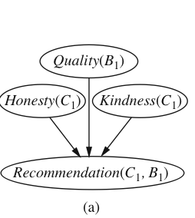
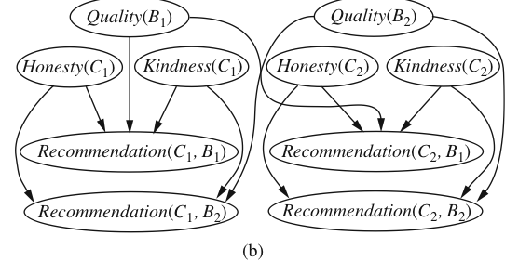
1st-order Bayes nets
Can we combine 1st-order logic with Bayes nets?
Basic idea: use nodes with 1st-order variables, like Prolog Horn clauses.
For inference, follow grounding approach to 1st-order reasoning.
Important open topic, many researchers working on this, including yours truly.

Slide 54
Summary
Bayes nets represent probabilistic knowledge in a graphical way using conditional probabilities.
Used in many applications and companies.
The graph encodes dependencies (correlations) and independencies.
Supports efficient probabilistic queries.
Bayes’ theorem is a formula for abductive reasoning, from effect to cause.
Notes:
Key concepts:

